Slide 1
Pairwise DE analysis
1 hr
Enzymes
1 peptidase
174 DEGs 71 upregulated in no prey
103 upregulated in prey
Enzymes
1 chitinase
1 lipase
1 peroxidase
1 protease
4 phosphatases
3 peptidases
24 hr
Enzymes
1 lipase
3 phosphatases
151 DEGs 2 upregulated in no prey
149 upregulated in prey

Slide 2
DEG GO Term Classification

Slide 3
GO Term Classifications Comparison
Only in 1 hr DEG’s
Biological Process
Immune system process
Molecular Function
Molecular Function Regulator
ATP-dependent Activity

Slide 4
GO Term Classifications Comparison
Biological Process
Reproductive Process
Reproduction
Multicellular Organismal
Developmental Process
Only in 24 hr DEG’s
Molecular Function
Transcription regulator activity
Molecular adaptor activity

Slide 5
DEG Network Module Correspondence

Slide 6
Prey Vs. No Prey 1 hr time point
Prey Vs. No Prey 24 hr time point
174 DEGs
151 DEGs

Slide 7
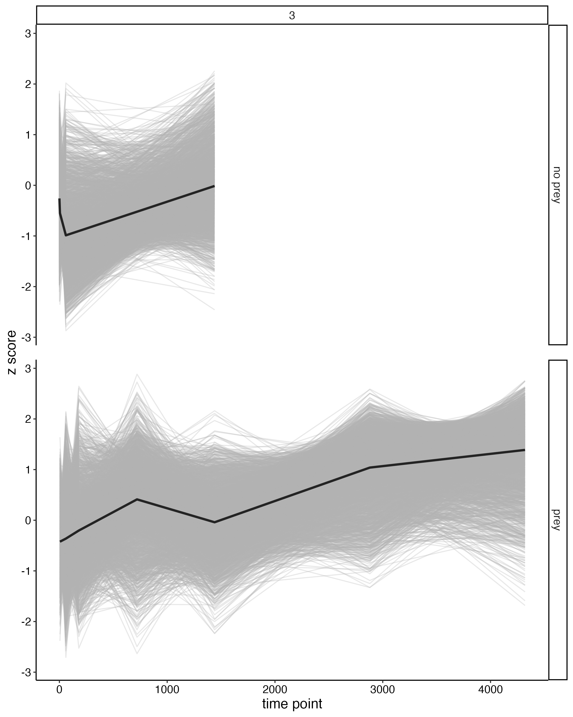
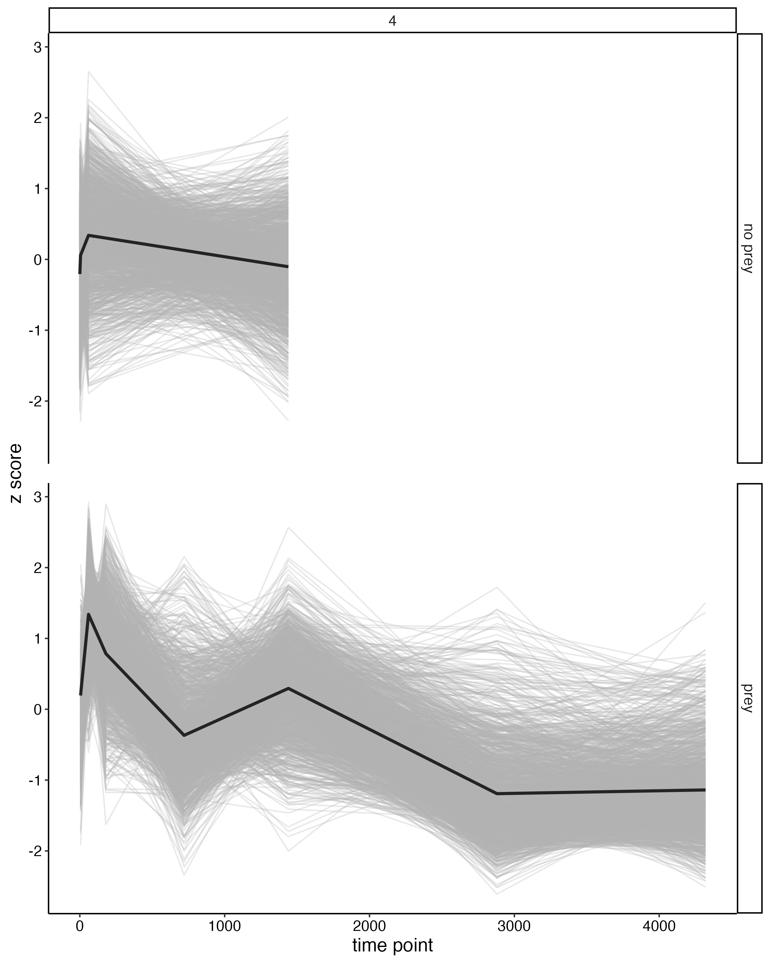
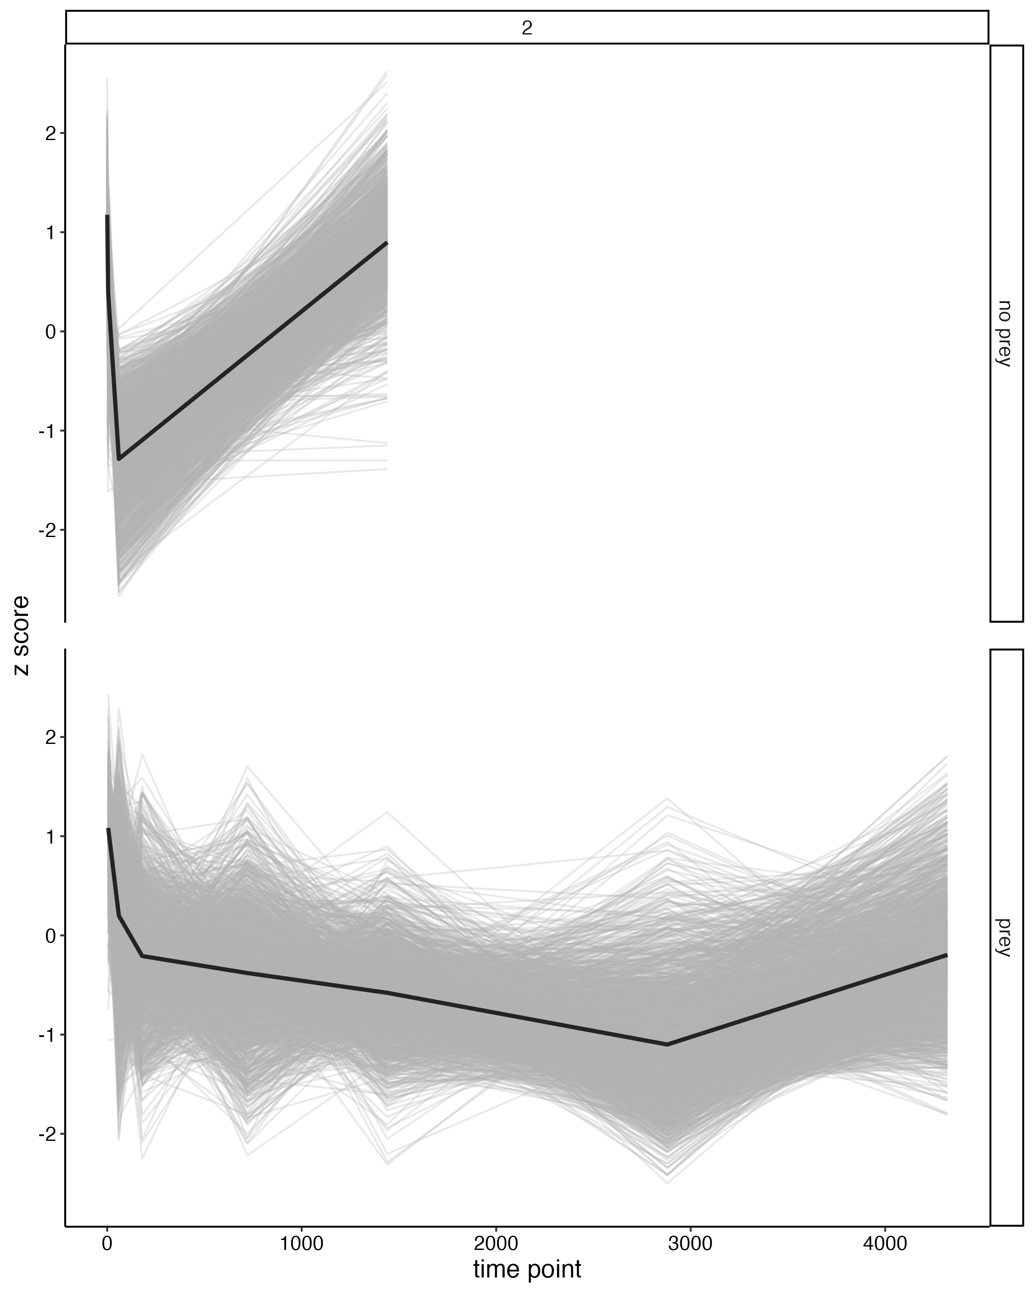
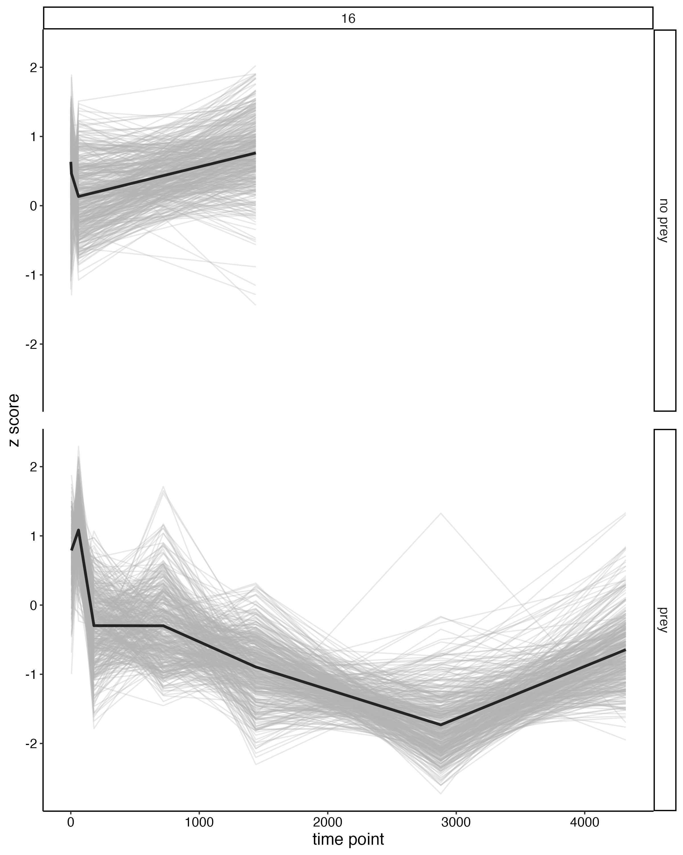
Prey Vs. No Prey 1 hr time point
103 upregulated in prey module 2,3,4,16

Slide 8
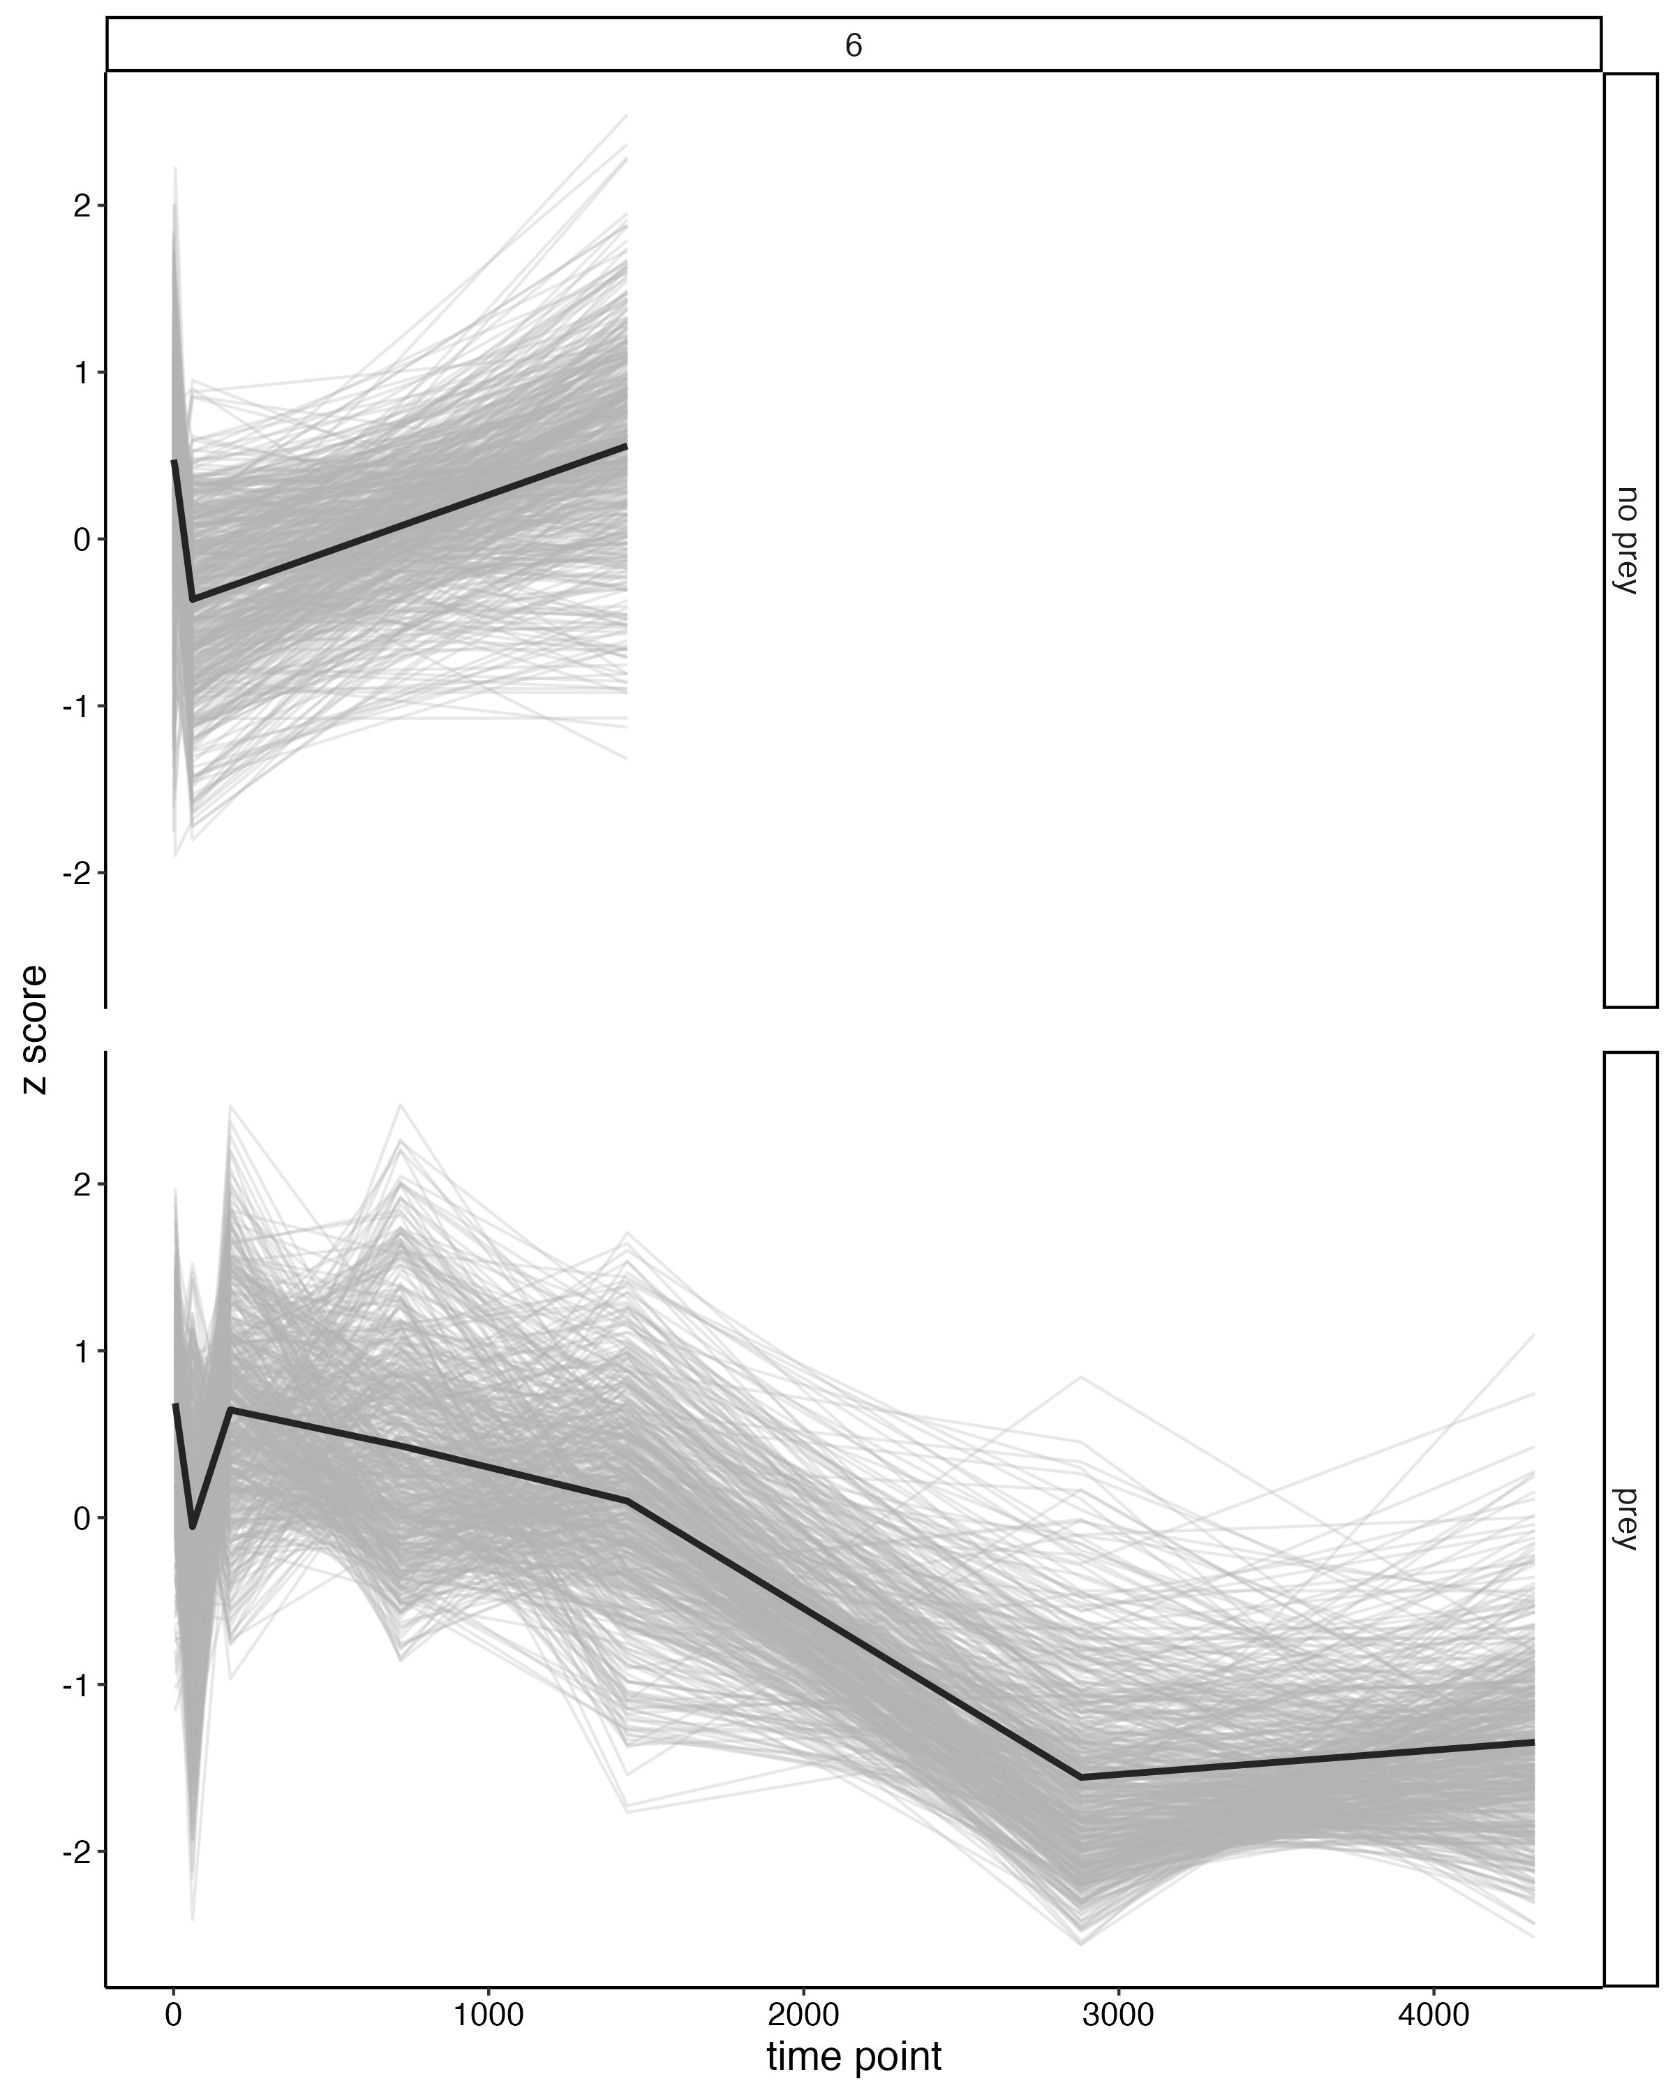
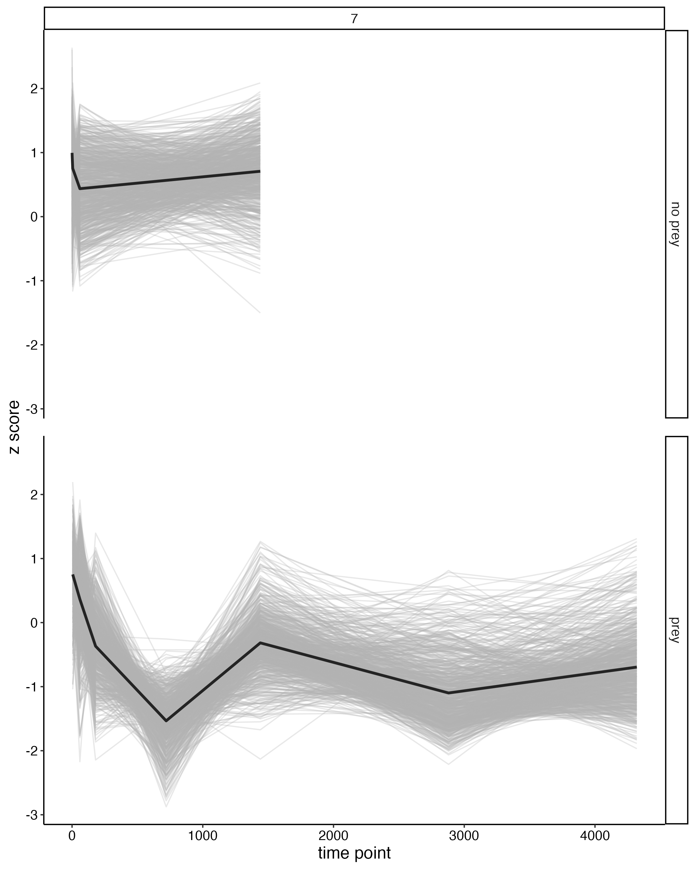
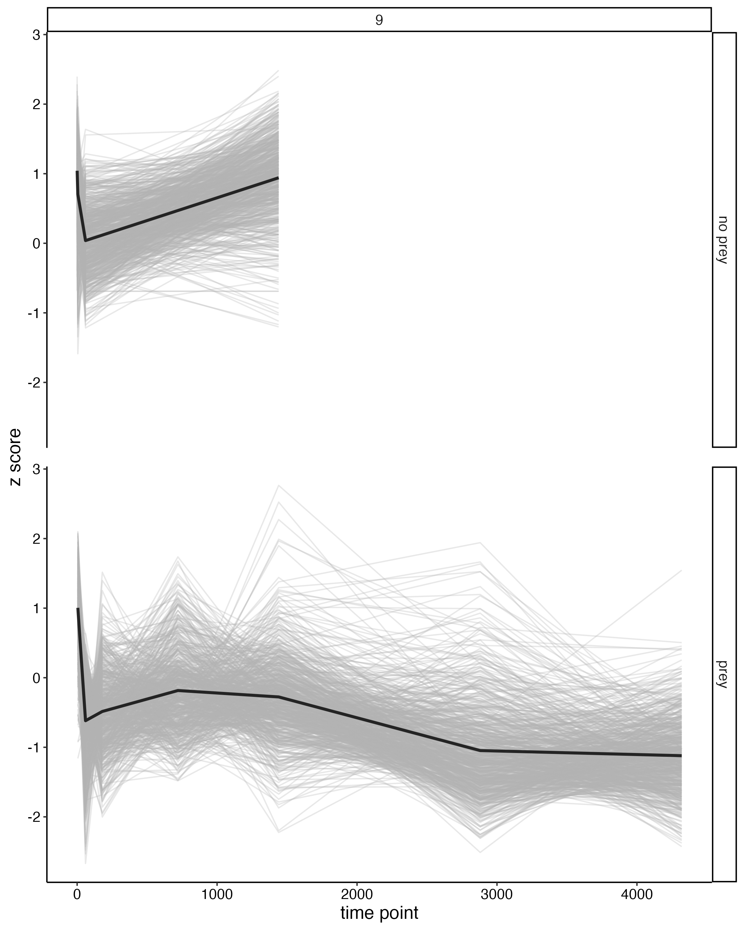
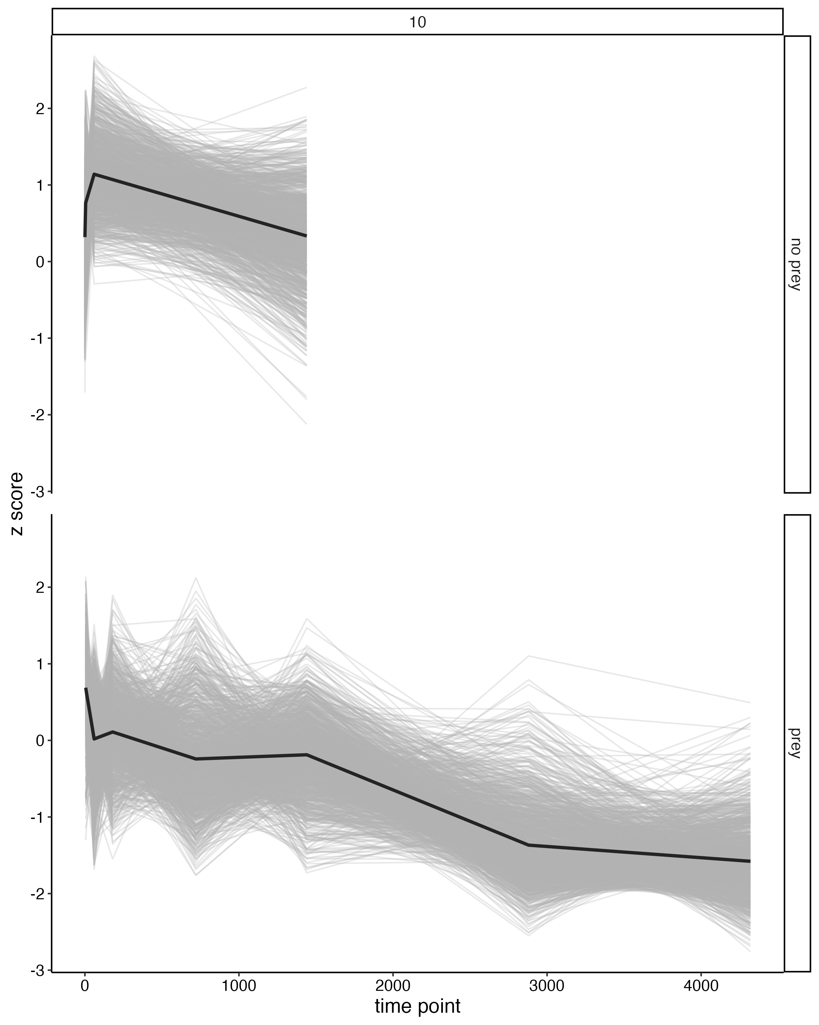
Prey Vs. No Prey 1 hr time point
71 upregulated in no prey –
module 3,6,7,9,10

Slide 9
Prey Vs. No Prey 24 hr time point
2 genes with higher expression in Mechanical Trigger –
module 2 and 6

Slide 10
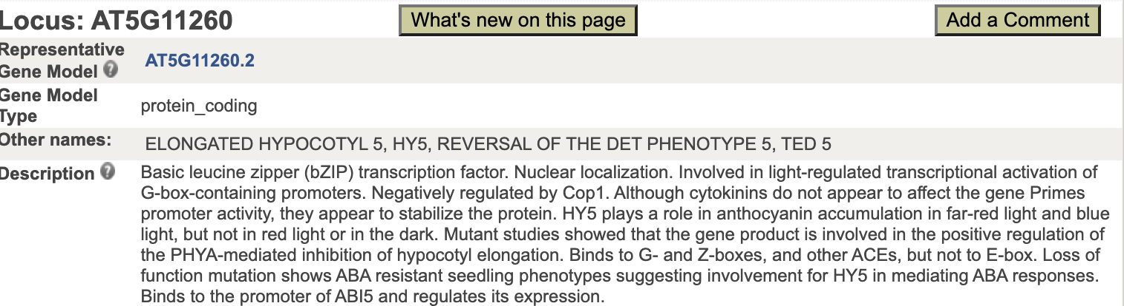
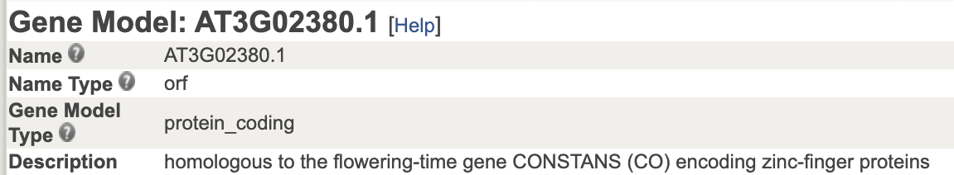
Prey Vs. No Prey 24 hr time point
2 genes with higher expression in Mechanical Trigger –
module 2 and 6

Slide 11
Prey Vs. No Prey 24 hr time point
149 genes with higher expression in Prey Trigger –
Modules 3, 4, 6

Slide 12
Network Module GO Classification

Slide 13
Module 3 GO Term Classification
3009 genes in module
~600 genes associated with metabolic process
~700 genes associated with cellular process
~500 genes associated with catalytic activity
~400 genes associated with binding

Slide 14
Module 4 GO Term Classification
1455 genes in module
~200 genes associated with metabolic process
~300 genes associated with cellular process
~200 genes associated with catalytic activity
~150 genes associated with binding

Slide 15
Module 10 GO Term Classification
1239 genes in module
~200 genes associated with metabolic process
~250 genes associated with cellular process
~200 genes associated with catalytic activity
~150 genes associated with binding

